Slide 1

HCL
TECHNOLOGIES
Submitted By
Rohit 12200788
Divyanshi 12200802
Shobhana 12200805
Vanshika 12200814
Geetanjally 12200821
Animesh 12200842
Submitted To
Ms. Bhavya Kaushal

Slide 2

About Company
• Company Name: HCL Technologies (HCLTech)
• Founded: August 11, 1976
• Founder: Shiv Nadar
• Headquarters: Noida, Uttar Pradesh, India
• Industry: IT Services, Consulting, Engineering & R&D, Software Products,Cloud, AI
• Employees: ~22,00,000 (2025), served 60+ Co.
• Stock Symbol: NSE: HCLTECH, BSE: 532281
• Market Capitalization (2025): Over ~ ₹4.5T, making HCLTech one of India’s top IT companies.

Slide 3

CORE
BUSINESS
02
IT Services: App dev, Maintenance, Infrastructure management.
Engineering and R&D Services (ERS): Product dev, Platform eng, IoT Works.
Products and Platforms (P&P): Provides software products.
HCL Enterprise (Parent Group): Includes HCLTech, HCLHealthCare, and HCLInfra.

Slide 4
HISTORY
AND
BACKGROUND
1976: Genesis: Founded by Shiv Nadar (Microcomp Ltd.). - Indigenous calculators & microcomputers.
1978: HCL 8C: Launched India's first 8-bit microcomputer (Hindustan Computers Ltd.).
1991: Global Pivot: Established HCL Technologies for global IT services and software exports.
2000s: Growth Strategy: Infrastructure Management Services (IMS) and 'Ideapreneurship'.
01
02

Slide 5

MISSION
VISION
"SuperCharge Progress"
- by combining technology and its. people to drive client success.
- To be a next-gen global tech. company that helps enterprises reimagine their businesses for the digital age by supercharging progress responsibly for clients, employees, and communities.
04

Slide 6

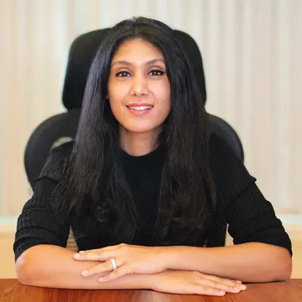
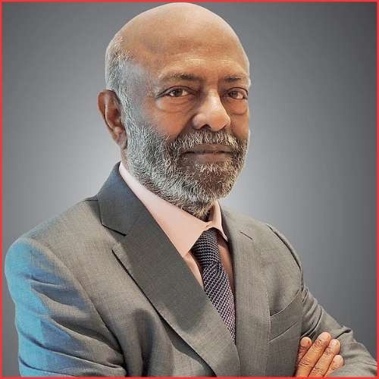
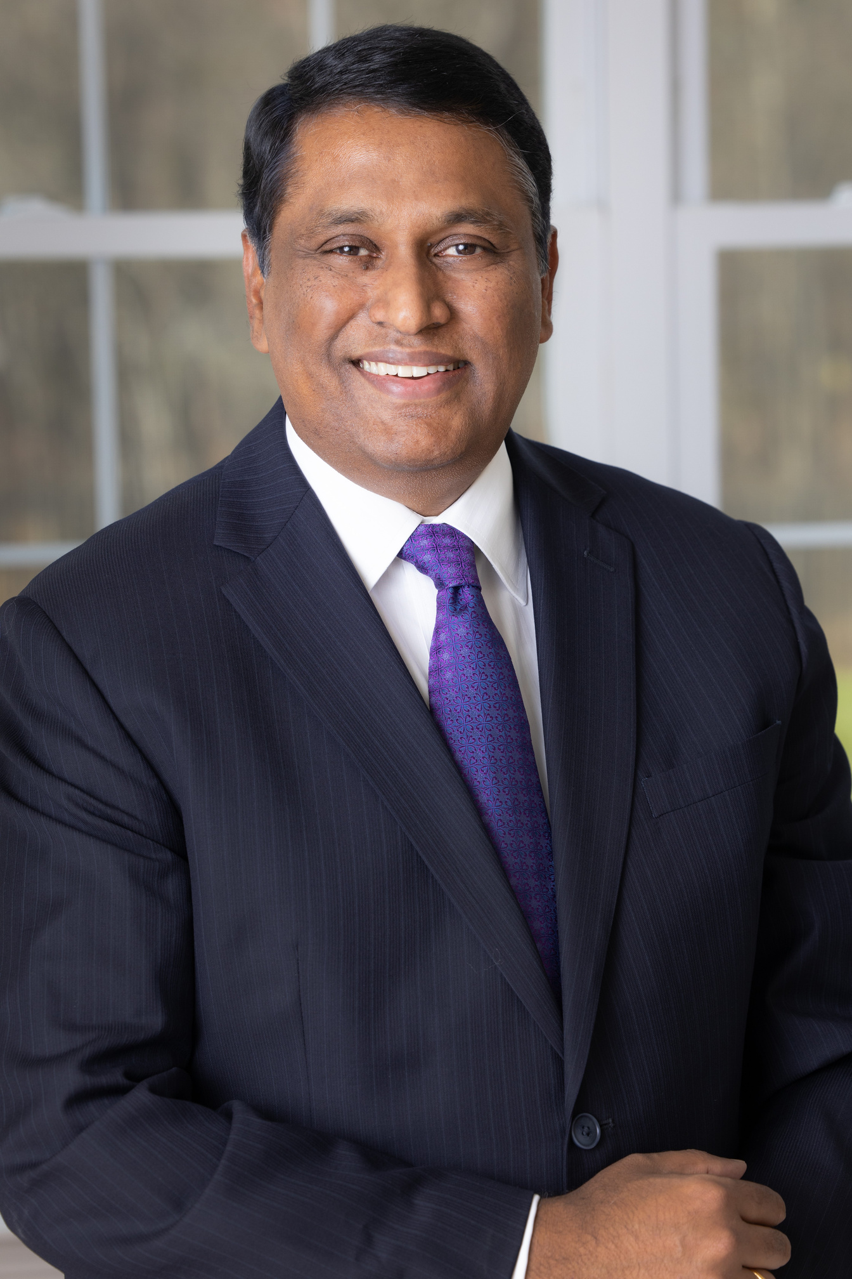
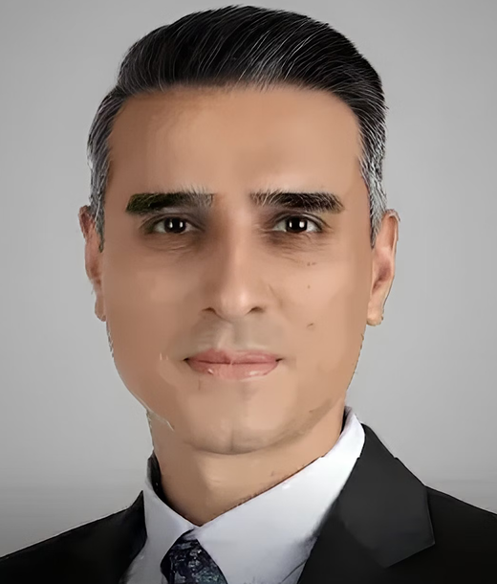
Board of Directors
Roshni Nadar Malhotra
Chairperson,
Non-Executive and
Non-Independent
Shiv Nadar
Founder, HCL Group; Chairman Emeritus and Strategic Advisor to the Board
C Vijayakumar
Chief Executive Officer & Managing Director
Shikhar Malhotra
Director,
Non-Executive,
Non-Independent

Slide 7
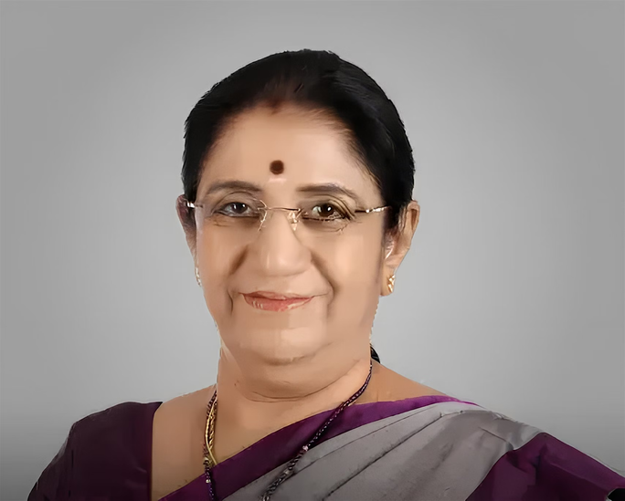
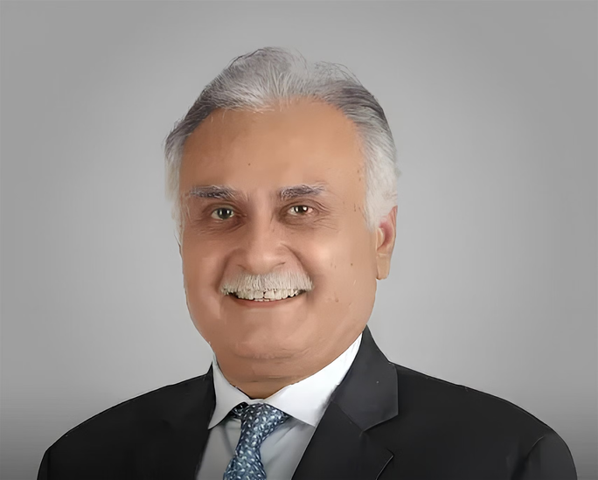
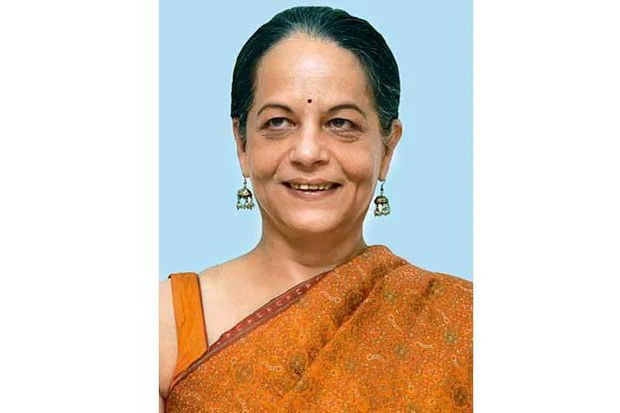
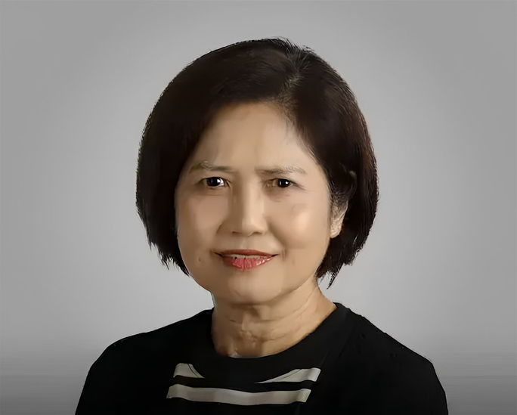
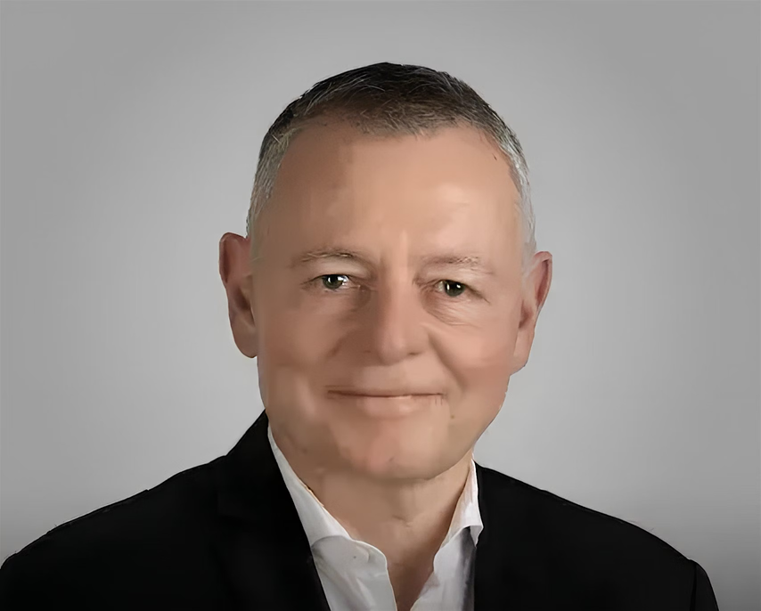
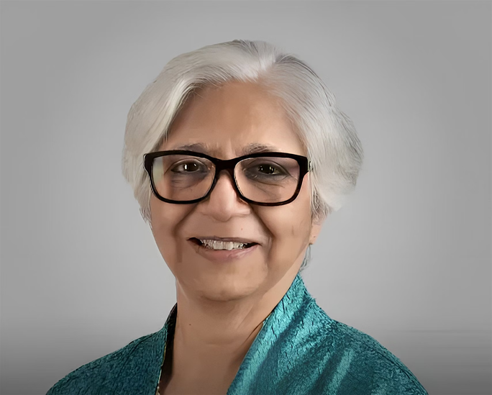
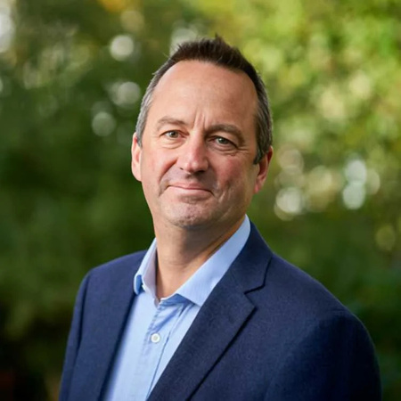
Non-Executive, Independent Directors
Bhavani Balasubramanian
Director
Deepak Kapoor
Director
Nishi Vasudeva
Director
Lee Fang Chew
Director
Vanitha Narayanan
Director
Simon John England
Director
Thomas Sieber
Director

Slide 8
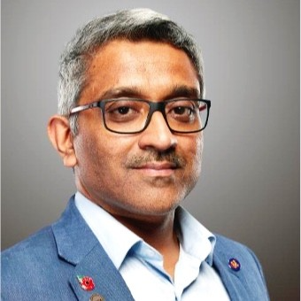
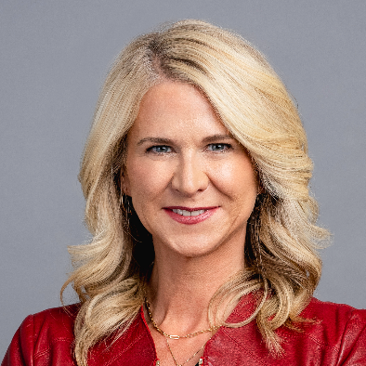
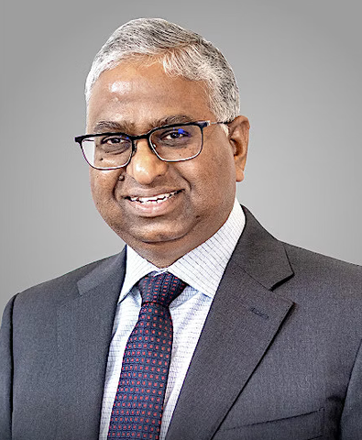
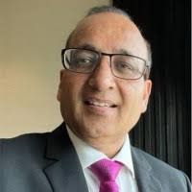
Key Management Team
The Key Management Team includes top executives who oversee and manage the company’s major functions. They ensure smooth daily operations and work toward achieving the company’s goals.
C Vijayakumar
Chief Executive Officer & Managing Director
Kalyan Kumar
Chief Product Officer
Jill Kouri
Chief Marketing Officer
Hari Sadarahalli
Global Head, Engineering & R&D Services
Shiv Walia
Chief Financial Officer

Slide 9

COMPANY ANALYSIS
RISK ANALYSIS
COMPETITION
Market Competition
Operational Risk
Financial Risk
Compliance and legal Risk
Geopolitical Risk
TCS (Tata Consultancy Services)
Infosys
Wipro
Tech Mahindra
IBM (International Business Machines)
Capgemini
MARKETING
Product
Place (Distribution)
Price
Promotion

Slide 10
LATEST NEWS
HCLTech made headlines by being recognized for its artificial intelligence (AI) work with new business wins and growth in the use of AI tools.
HCLTech has continued to pay out good dividends to its shareholders. In October 2025, it announced an interim dividend of ₹12 per share.
The company has announced a new partnership with MIT Media Lab, meaning they’ll work together on future technology research
HCLTech expanded its partnership with Zscaler, a top security company, to offer advanced AI-powered network security and protection for businesses.
HCLTech was named to TIME Magazine's World's Most Sustainable Companies list for 2025.
In 2025, HCLTech was voted as a “Customers' Choice” in Gartner’s Peer Insights list for managed network services, which shows clients are very satisfied with the company’s technology.

Slide 11
DEVELOPMENTS
MAJOR FINANCIALS
HCLTech achieved “Microsoft Copilot Specialization,” meaning it is an expert at using Microsoft’s AI-based automation tools for large companies.
The company landed new business deals worth $2.569 billion in the quarter, a big jump from before.
It was named a leader for “GenAI-powered” (generative AI) delivery, which means it is seen as very strong in using cutting-edge AI to help other companies run better worldwide.
Most of the company’s money comes from the USA (56%), and then Europe (28%) and India (3%).
The latest reports show that HCLTech now earns over $100 million each quarter just from AI-related work and projects.
Profit after tax for the quarter was ₹4,236 crore, staying about the same as last year.

Slide 12
SWOT ANALYSIS
WEAKNESS
STRENGTHS
Strong global presence
Robust client base—Fortune 500 companies
Expertise in IT services & engineering R&D
Strong innovation focus (HCLTech Labs)
Consistent financial performance
High dependency on US & European markets
Strong competition affects pricing
Lower brand visibility vs TCS/Infosys
Higher attrition rates in workforce
Limited consulting-level services(planning the work)
OPPORTUNITIES
THREATS
Growing demand for cloud, AI & digital services
Expansion into emerging global markets
Rising need for cybersecurity solutions
Strategic partnerships & acquisitions
Growth in engineering services sectors
Intense global competition
Rapid technology shifts
Economic slowdowns reduce IT spending
Data privacy & cyber risks
Government regulations & visa challenges
06

Slide 13
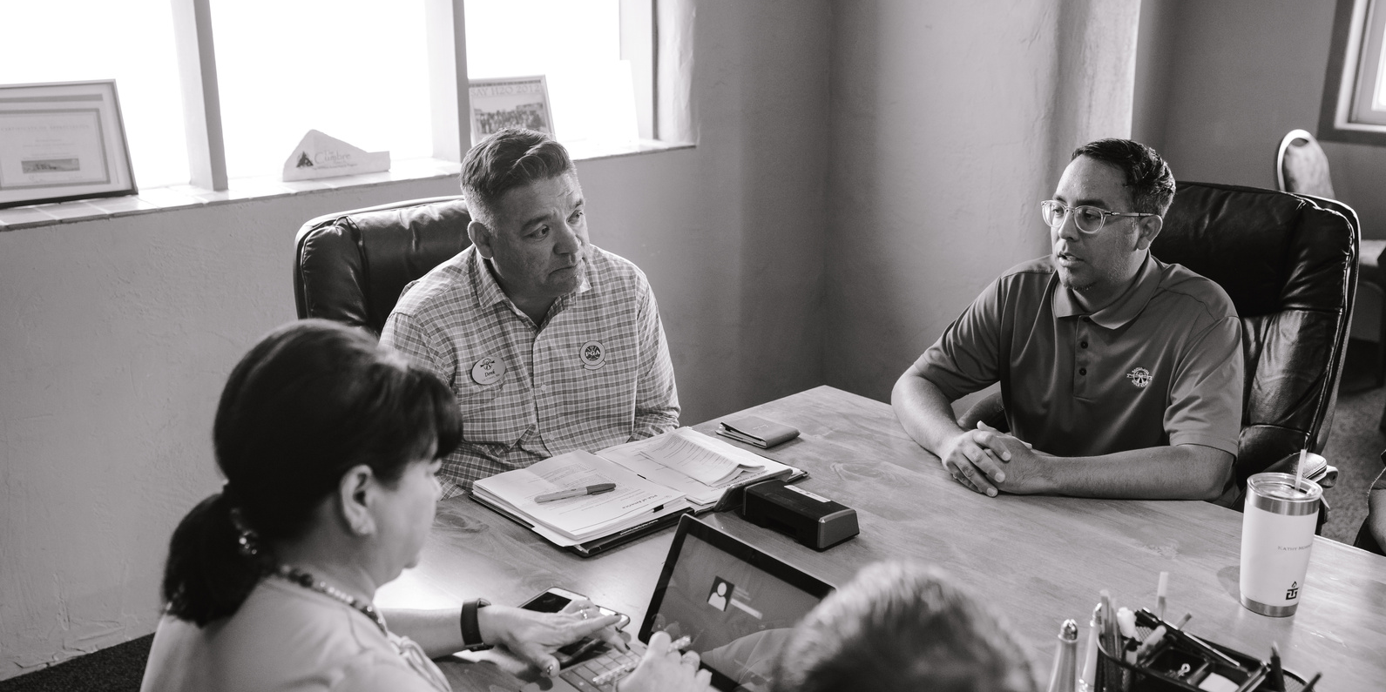

FUTURE GOALS
Strengthen the cloud, AI, and Cybersecurity portfolio
Expand presence in APAC, Europe & Middle East
Drive digital transformation for enterprises
Enhance consulting & high-value services
Focus on sustainability & ESG goals
Invest in workforce upskilling

Slide 14

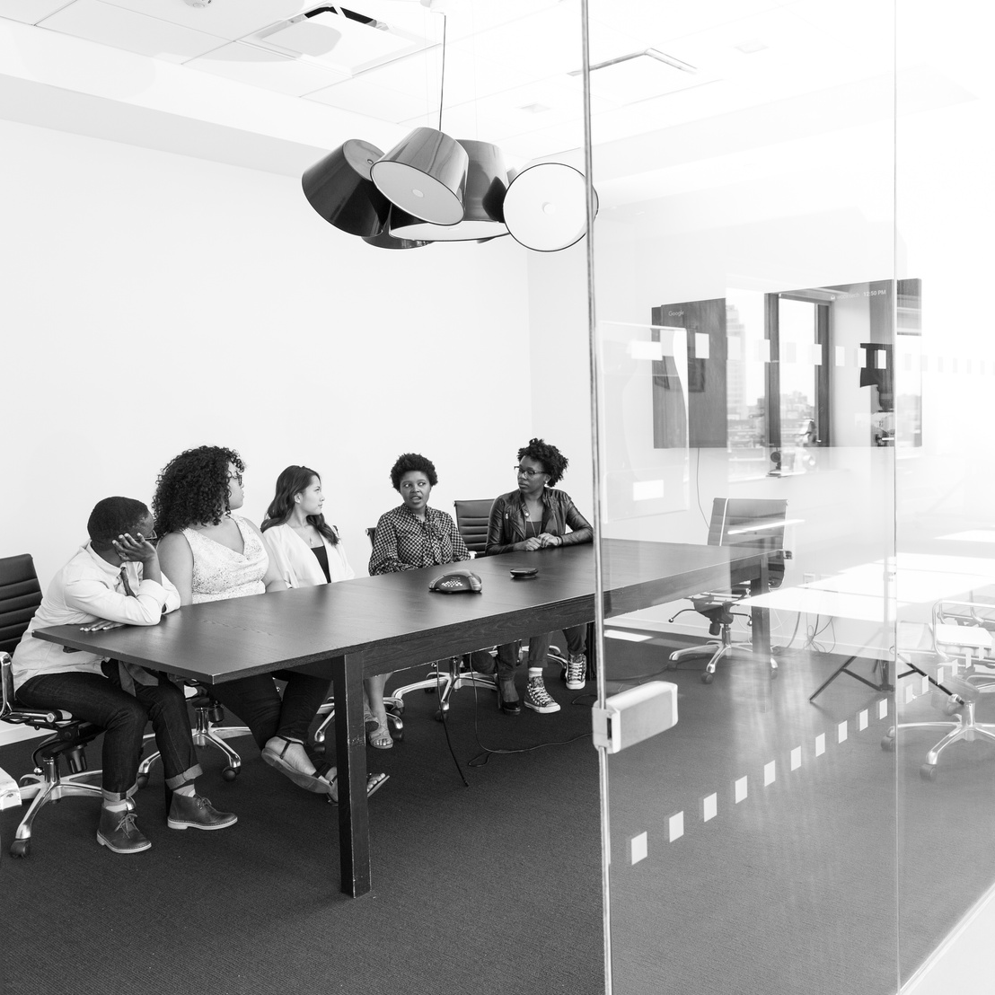
Revenue increased from ₹48,118 Cr (2024) to ₹51,105 Cr (2025) – strong growth.
Employee expenses increased to ₹22,414 Cr, reflecting expansion & talent investment.
Outsourcing and operating costs remained stable and efficient.
EBITDA supported by controlled other expenses.
Net Profit increased to ₹12,266 Cr from ₹11,674 Cr — solid profitability.
Earnings per share improved to ₹45.25.
Income Statement Analysis

Slide 15
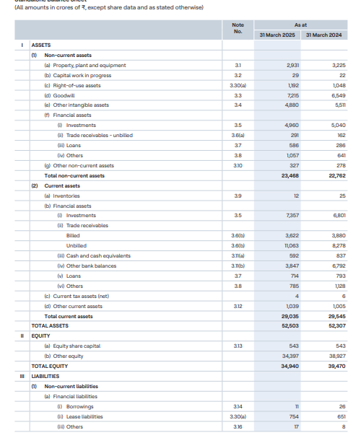
BALANCE SHEET

Slide 16
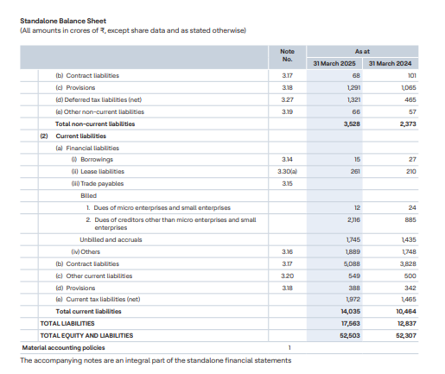



Assets
Total Assets: ₹52,503 Cr
Non-current assets stable; goodwill & intangibles remain major components
Trade receivables increased (₹14,685 Cr) → higher unbilled revenue
Cash & bank balances healthy at ₹4,439 Cr
Equity
Total Equity decreased from ₹39,470 Cr to ₹34,940 Cr
(due to high dividend payout)
Liabilities
Total liabilities increased to ₹17,563 Cr
Deferred tax liabilities jumped to ₹1,321 Cr
Contract liabilities surged → strong pipeline

Slide 17


Thank You

